Slide 1
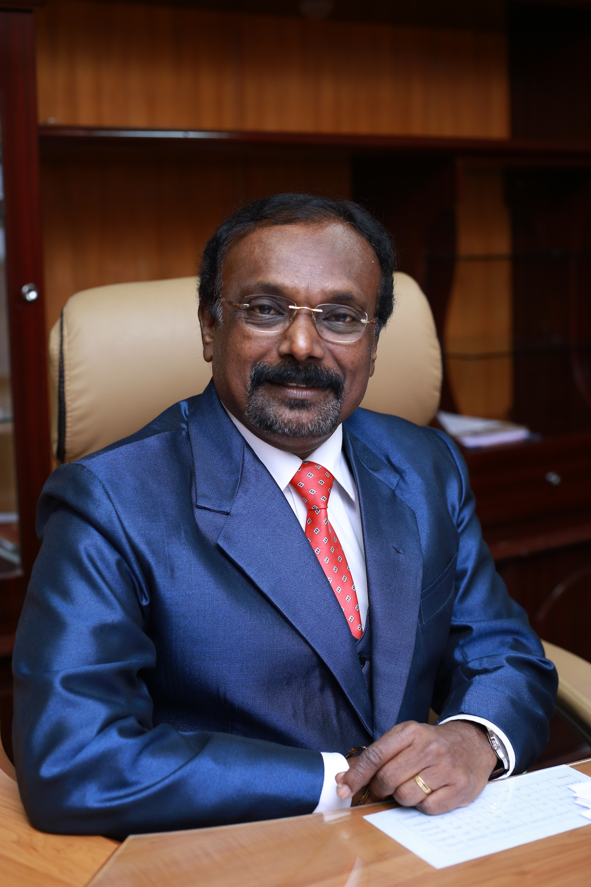
Dr. R. Somasekar
Present Designation:
Prof of peds SBMCH Chennai 44
Dean( Retd) KGMCH Asaripallam , Nagercoil, KK Dist
Professor of Pediatrics (Retd) Madras Medical College
ICH & HC Chennai - 600008
Past Affiliation:
MMC, Institute of Social obstetrics, Govt. Kasturbai Gandhi Hospital for women & children
Major Achievements (Honors/Awards/Publications):
Recipient of Best Doctor award from Friends Cultural Academy & Lions club
Rajiv Gandhi Award at New Delhi for conducting Maximum medical camps in Urban slums in Chennai
Active Paediatrician Award from IAP-TNSC in 2002
Membership to Professional Bodies:
Treasurer, Chennai Nutricon-2003
EB Member, Tamil-Nadu State Chapter 2006 - 2009
Trainer, Home Based New Born Care ,IMNCI ,IYCF, Human Lactation Management Course
Past Secretary & Past VP, Kancheepuram District branch of IAP
President Elect IAP – CCB 2016
Examiner Co-Guide ,PhD ,MD [Peads],Dip in NB &
MCI Inspector and E-Journal reviewer of Tamil-Nadu MGR Medical University
MD,DCH.FIAP
CHENNAI

Slide 14
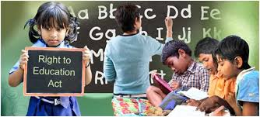
RIGHT TO EDUCATION
Article 21- A
Free and compulsory education to all children in age group 6 – 14 years
All government aided /private schools in india should provide 25% seats to children of economically backward sections of the society

Slide 15
RIGHT TO HEALTH AND NUTRITION
Articles 23 and 24
Medical care, nutrition, protection from drugs and safe working environments are covered under the right to health act.

Slide 16
RIGHT TO BE PROTECTED FROM ARMED CONFLICT
ARTICLES 38 AND 39
Government should ensure that children are not forced to participate in any armed struggle or conflict and ensure safe passage for them to freedom.
The Army of India or any army in the World is not Allowed to touch, harm or shoot children during Armed conflict.

Slide 17
CHILD LABOUR ACT
Most controversial and legislated Act related to children's right in India is
Child Labour Prohibition and Regulation Act, 1986.
Child below Age of 14 years should not be employed to do any kind of work.
If hired, the employer will face restrict action as per this Law.
In 2001, an estimated 1% of all child workers, or about 120,000 children in India were in a hazardous job and this Act was enforced more forcefully in the last 5 years.

Slide 18
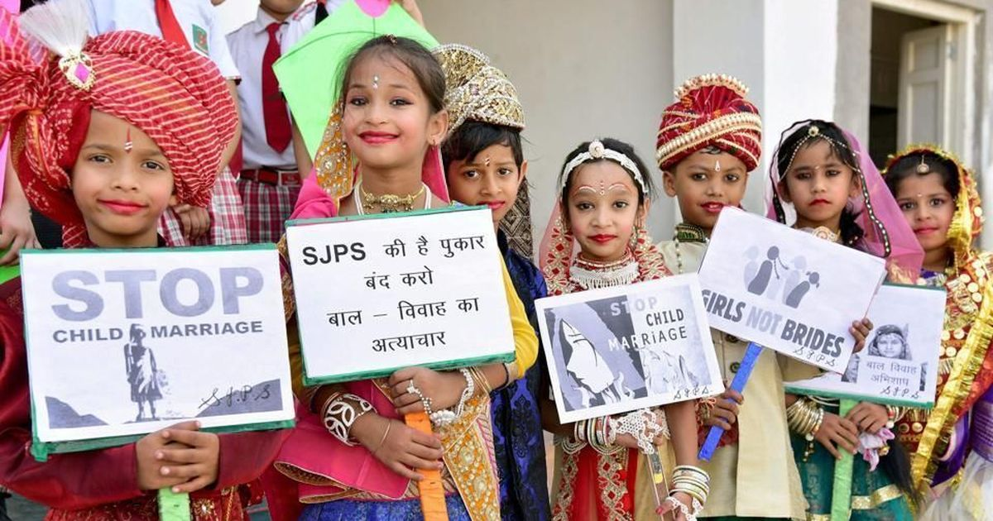
PROHIBITION OF CHILD MARRIAGE ACT
The Child Marriage Act in India was implemented from 1st November in 2007.
UNICEF defined the marriage of girls before the age of 18 years as a child marriage and below 21 years for boys and its violation is considered as the violation of human rights.

Slide 19
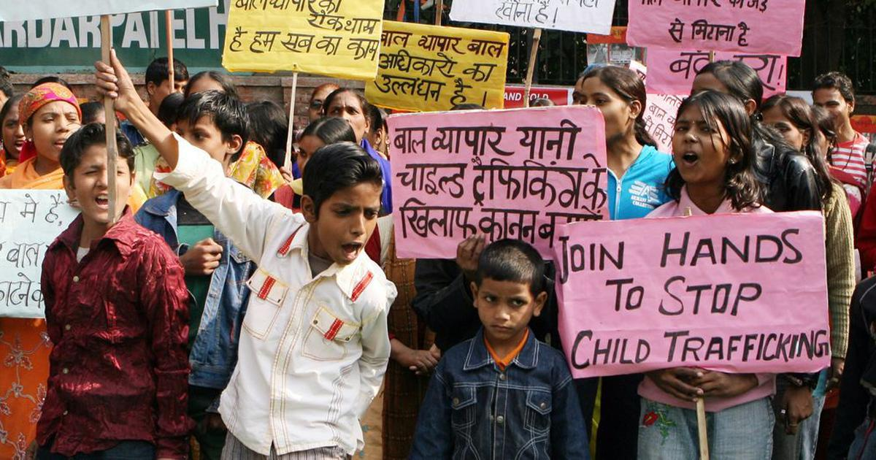
CHILD TRAFFICKING LAW
UNICEF calls for strict action and persecution if any person under the age of 18 is transported, transferred or sheltered for the purpose of exploitation.
According to International Labour Organisation, estimates are that 1.2 million children are trafficked each year.
Included under the crime of child trafficking.

Slide 20
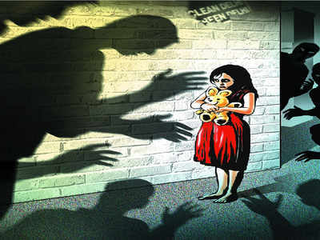
POCSO ACT - 2012
Protection of Children from Sexual Offences (POCSO)
53% of children in India face child abuse in some form
This law prohibits the display of vulgar graphics in front of the children and any kind of involvement of the children in such content related to children is also an offence.
This act makes child abuse a punishable offence wherein it places the burden of proof on the accused, and ensures rigorous punishment for all defaulters.

Slide 28
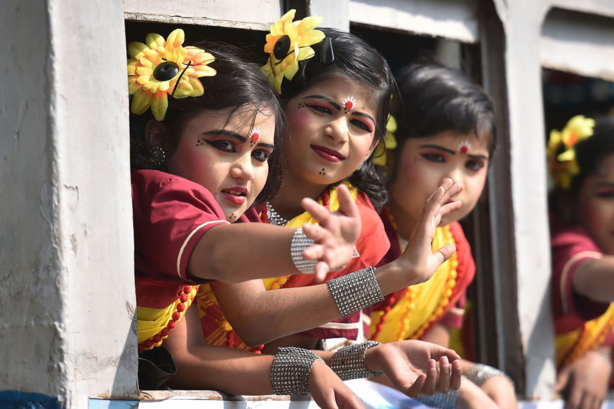
THANK YOU ALL

